Slide 1
pollen grains
Team Members
Adapa Madhurima
Chopparapu Showriraju
Bantrothu Seshadri Naidu
A Sai Santhosh

Slide 2
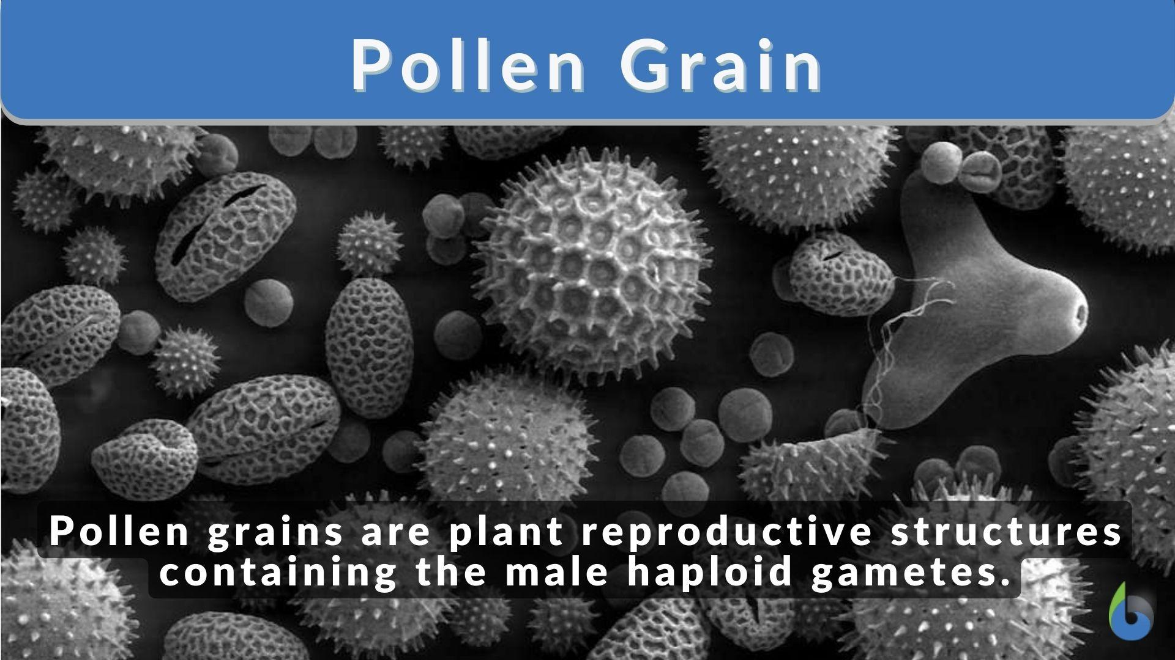
introduction
Pollen grains are microscopic structures produced by flowering and cone-bearing plants that carry the male reproductive cells (sperm cells). They are essential for plant reproduction as they facilitate pollination, the transfer of the male reproductive material to the female part of the flower. Pollen grains are incredibly tiny, often requiring magnification to be seen in detail, and their study is known as palynology.

Slide 3
contents
What are pollen grains
Formation
Structure
Function of pollen grains
Specturm of possible pollen types
Pollination
forensic
Case study
references

Slide 4
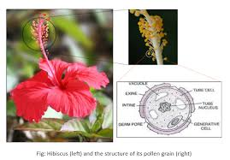
What is pollen grains
a pollen grains is a microscopic body that
contains the male reproductive cell(sperm cell)
of a plant.
it is crucial in a plants fertilization process.

Slide 5
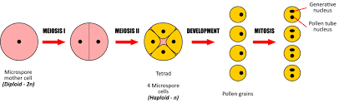
formation
In angiosperms , produced by the anthres of the stamens.
in gymnosperms, formed in the microsporophslls of the microstrobili (male
pollen cones).

Slide 6
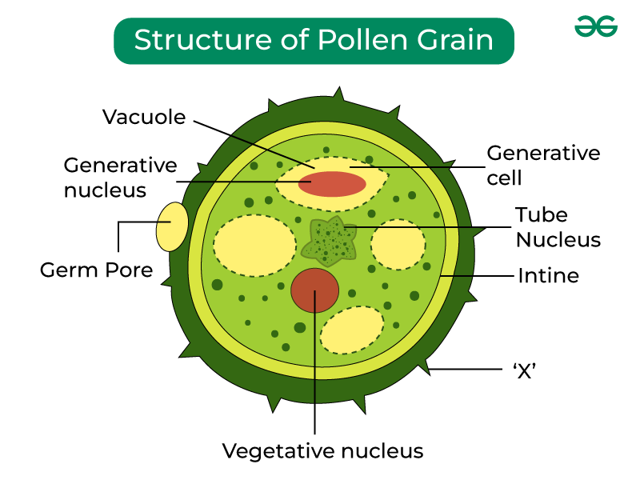
Structure of pollen grains
A pollen grain, also known as a microspore, is a plant's male reproductive cell.
It's typically spherical and has a two-layered wall: an outer exine and an inner intine. The exine is composed of sporopollenin, a highly resistant substance that protects the pollen grain. The vegetative cell provides nutrients, while the generative cell will eventually divide to form two sperm cells.

Slide 7
Function of pollen wall
The pollen wall, also known as the sporoderm, primarily functions to protect the male gametophyte (the pollen grain) during its transfer from the anther to the stigma of another flower. It also regulates water uptake and loss, controls pollen germination and tube growth, and plays a role in cell-cell recognition during pollination.

Slide 8
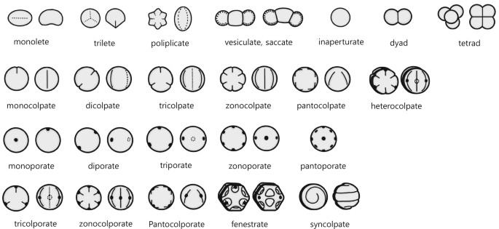
Spectrum of possible pollen types

Slide 9
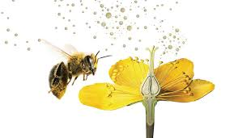
pollination
Pollination is the process of transferring pollen from the male part of a flower (anther) to the female part (stigma), which is essential for plant reproduction and ultimately, the production of fruits and seeds. This process can occur within the same flower (self-pollination) or between different flowers (cross-pollination). Pollination relies on various agents like insects, wind, water, or animals.

Slide 10
Case study
pollen grains, despite their microscopic size, offer a wealth of information in various fields, from forensic science to ecology and even agriculture. Case studies demonstrate their utility in identifying locations, linking suspects to crime scenes, and understanding past climates. Forensic palynology, in particular, utilizes pollen's unique characteristics to analyze trace evidence and aid in criminal investigations.

Slide 11
conclusion
Pollen grains are microscopic structures that are essential for plant reproduction. They carry the male gametes (sperm cells) and are crucial for pollination, the process of transferring pollen to the female part of the flower, which leads to fertilization and seed formation. Pollen grains are produced in the anther of a flower and are dispersed by various agents like wind, water, insects, and other animals. The outer layer of the pollen grain, called the exine, is highly resistant to decay, which allows pollen to be preserved in the fossil record and studied by scientists.

